Slide 1
Social Media Malignant Comment Detection Project

Slide 2
Problem Statement
To detect the malignant social media comments.
The data for this project was obtained from kaggle website. There are two dataset, one for training purpose and another for testing.

Slide 3
Background
Abusive language, aggression, cyber bullying, hatefulness has been identified as a major threat on online social media platforms.
This comments can take a toll on anyone and affect them mentally leading to depression, mental illness, self-hatred and suicidal thoughts.
Data science can play a key role in this domain by helping user distinguish malignant comment from non malignant with the help of Machine Learning model classifier.

Slide 4
Data Analysis
First step is to create new column feature named ‘Malignant comment’ in both the dataset.
Rowwise calculate the sum of values of the 6 features (malignant, highly malignant, rude, abuse and threat)
Based on previous step, insert 0 as value in the new feature labelled malignant comment if the sum of the column values is greater than 1 or else insert 1.
.

Slide 5
Next we get insight of the dataset by determining the shape of data and finding the data type.
Later we perform null value analysis to detect any missing data. Since there were no null values or empty string detected in our dataset, we move to next step.
Using visualization techniques we perform univariate, bivariate analysis.

Slide 6
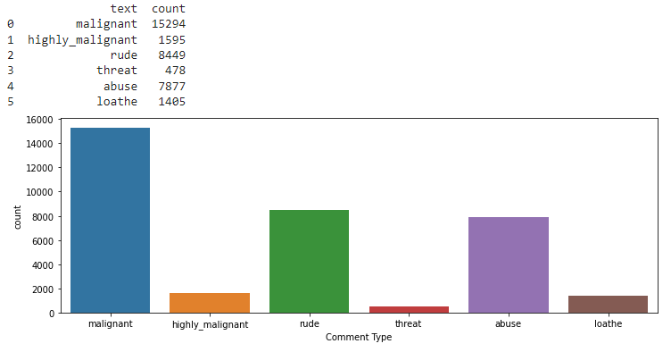
Types of comments
Majority of abusive comment fall under malignant category followed by rude
comments.

Slide 7
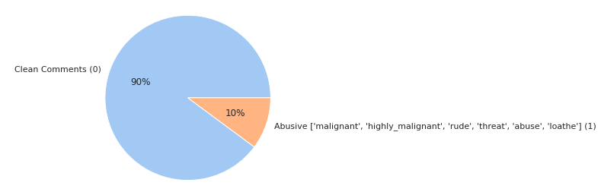
Distribution of malignant and non malignant comments in dataset
90% of the comments from the dataset are non malignant while remaining
10% are found to be either malignant, highly malignant, rude, threat, abuse
or loathe.

Slide 8
Data Cleaning Procedure
First we append the news title to news text and drop the news title column.
Perform html parsing using beautiful soup, to scrap the text between html tags.
Next, we remove https and .com links from the text and then then split the text to convert it into lower case.
Then we remove all the numbers from the string and using regular expression sets, strip everything other than word and whitespace (like brackets, symbols etc)
Later we eliminate the stopwords and punctuations from the text.

Slide 9
We perform Lemmatization i.e. converting the word to its meaningful base form by looking at its context.
Since overstemming and understemming are two problems that can arise in stemming. For example, the word “fishing” might be overstemmed to “fishin,”.Hence lemmatization text preprocessing which has higher accuracy is preferred over stemming.
Remove any single character, if remaining in the text.
Lastly drop rows with empty strings.
After data cleaning we perform more visualization.

Slide 10
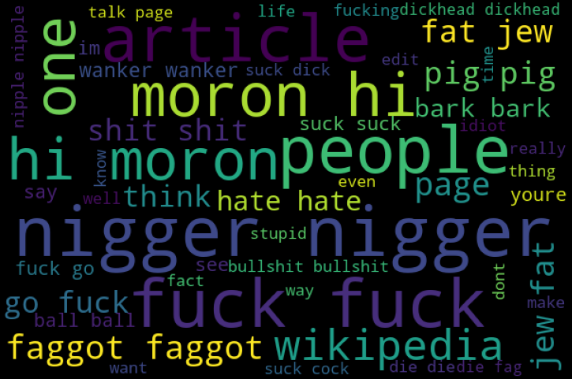
World Cloud (Malignant Comment)
Approx. 250 words in text is most common in original text category
while approx 500 words in text is most common in fake text category.

Slide 11
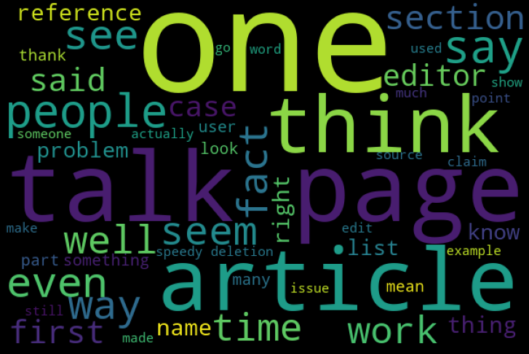
World Cloud (Non Malignant Comment)
Approx. 250 words in text is most common in original text category
while approx 500 words in text is most common in fake text category.

Slide 12
Next we perform unigram, bigram and trigram analysis.
After computing word counts using ‘CountVectorizer’ we then compute the IDF values followed by Tf-IDF scores.
After that process is complete, we feed the Tf-IDF vectorizer data into the machine learning model for testing.
Then we select and save the best working model based on the results obtained.

Slide 13
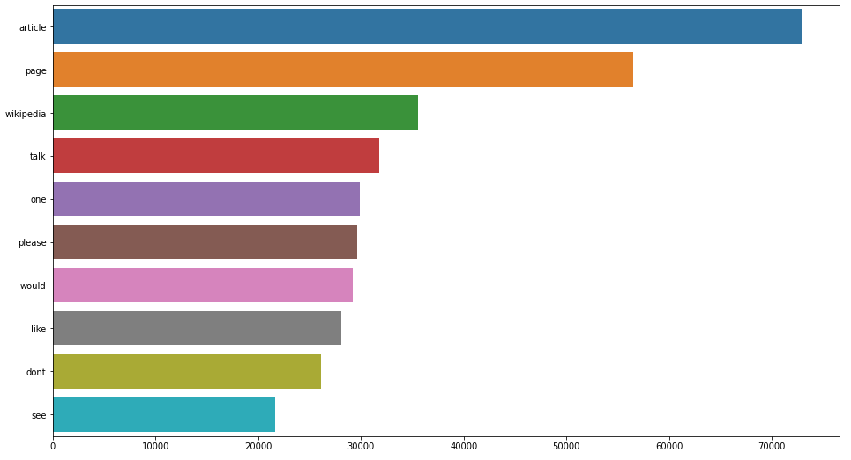
Unigram Analysis
Article is the most repeated word in entire dataset text.

Slide 14
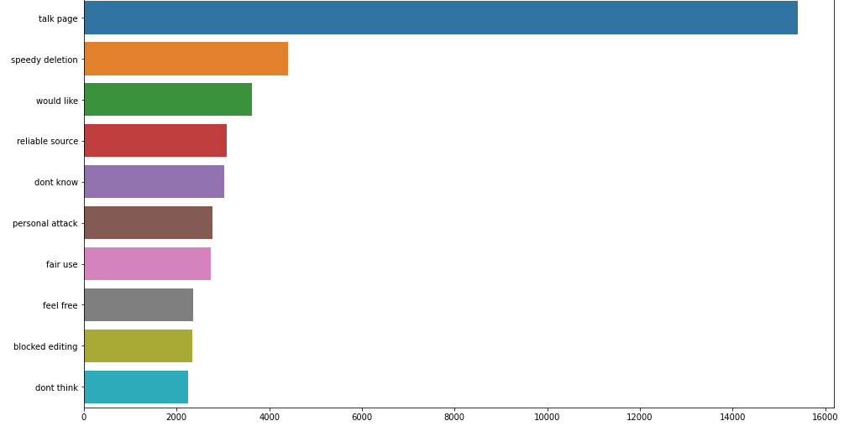
Bigram Analysis
Talk page is the most repeated bigram in entire dataset text.

Slide 15
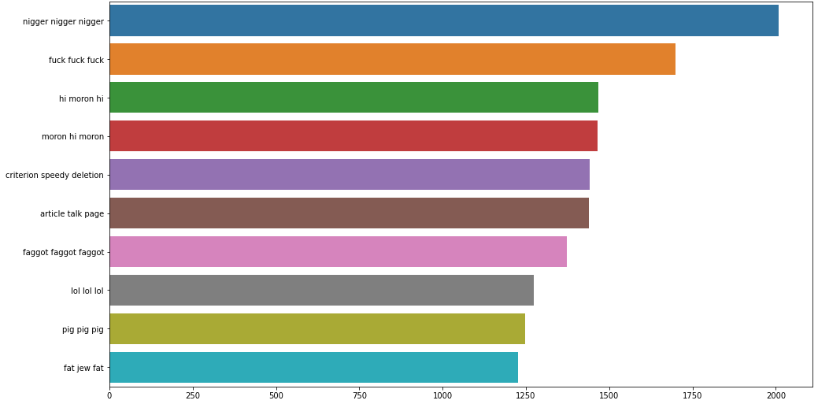
Trigram Analysis
Nigger nigger nigger is the most repeated trigram in entire dataset text.

Slide 16
Conclusion
In this study we found that logistic regression algorithm performs slightly better than other classifiers and rest of the algorithm tested.
Hence we were successful able to detect the malignant comment with minimum error.

